Slide 1
CSS Grids

Slide 2
Agenda
Why CSS Grids
Browser Support
Import Terminology
Explicit and Implicit Grid
Demos

Slide 3
What is CSS Grid
CSS Grid Layout is completely changing the game for web design. It allows us to create complex layouts on the web using simple CSS.
CSS Grid Layout is the most powerful layout system available in CSS. It is a 2-dimensional system, meaning it can handle both columns and rows, unlike flexbox which is largely a 1-dimensional system.
It is a web standard, just like HTML, and it works in all modern browsers.
With CSS Grid Layout you can create precise layouts for the web. You can build orderly columns and rows, or artful overlapping content areas to create stunning new designs.

Slide 4
Why learn CSS Grids layout?
EASIER TO CREATE TWO DIMENSIONAL LAYOUTS
SIMPLER MARKUP
FLEXIBLE
SKIP FRAMEWORKS
BROWSER SUPPORT

Slide 5
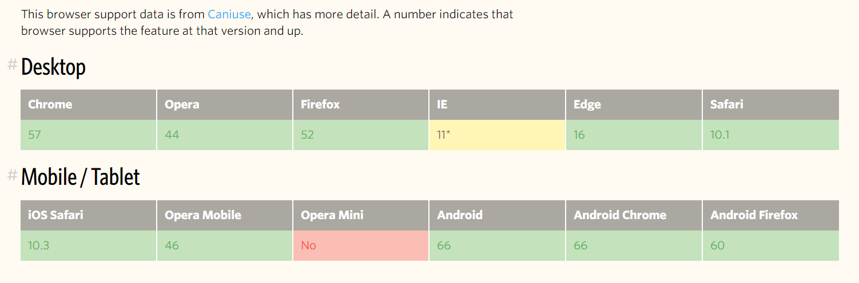
Browser support
As of March 2017, most browsers shipped native, unprefixed support for CSS Grid: Chrome (including on Android), Firefox, Safari (including on iOS), and Opera. Internet Explorer 10 and 11 on the other hand support it, but it's an old implementation with an outdated syntax. The time to build with grid is now!

Slide 6
Important Terminology
Before diving into the concepts of Grid it's important to understand the terminology. Since the terms involved here are all conceptually similar, it's easy to confuse them with one another if you don't first memorize their meanings defined by the Grid specification. But don't worry, there aren't many of them.
The two core ingredients of a CSS Grid are the wrapper (parent) and the items (children). The wrapper is the actual grid and the items are the content inside the grid.
Grid Container
Grid Item
Grid Line
Grid Track
Grid Cell
Grid Area

Slide 7
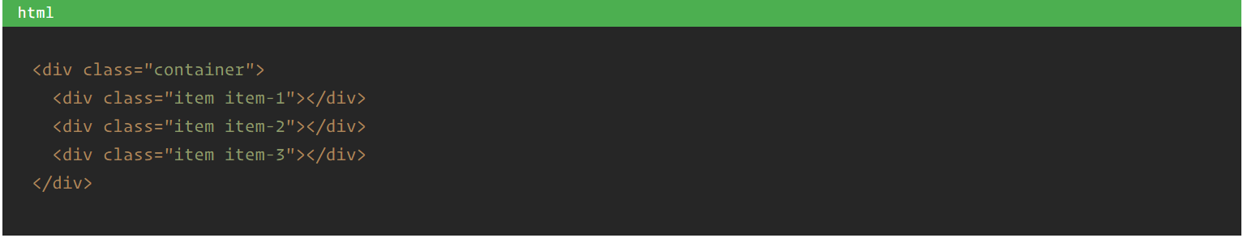
Grid Container
The element on which display: grid is applied. It's the direct parent of all the grid items. In this example container is the grid container.

Slide 8
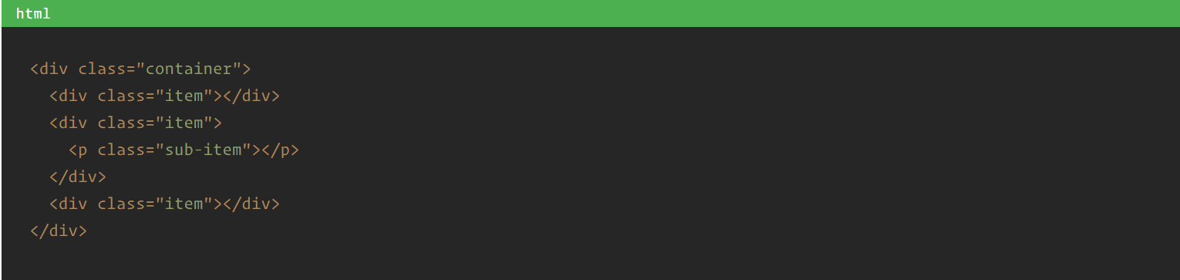
Grid Item
The children (e.g. direct descendants) of the grid container. Here the item elements are grid items, but sub-item isn't.

Slide 9
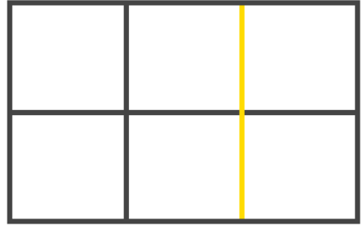
Grid Line
The dividing lines that make up the structure of the grid. They can be either vertical ("column grid lines") or horizontal ("row grid lines") and reside on either side of a row or column. Here the yellow line is an example of a column grid line

Slide 10
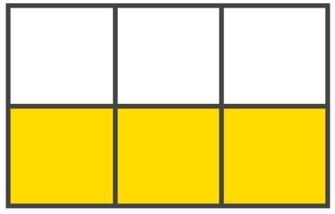
Grid Track
The space between two grid lines. This space can be horizontal or vertical. Here's the grid track between the second and third row grid lines

Slide 11
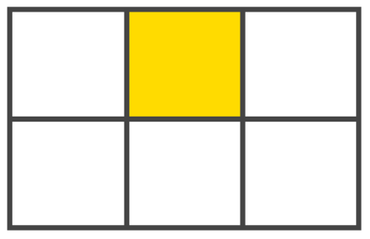
Grid Cell
The space between two adjacent row and two adjacent column grid lines. It's a single "unit" of the grid. Here's the grid cell between row grid lines 1 and 2, and column grid lines 2 and 3.

Slide 12
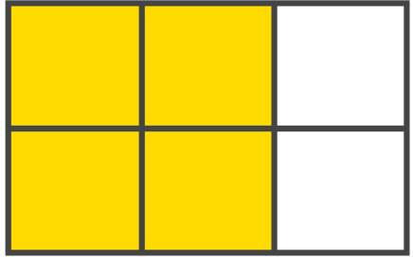
Grid Area
A rectangular space surrounded by four grid lines. A grid area can contain any number of grid cells. Here's the grid area between row grid lines 1 and 3, and column grid lines 1 and 3.

Slide 13
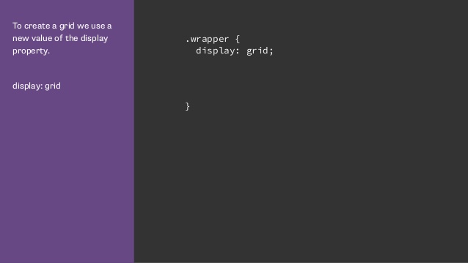

Slide 14
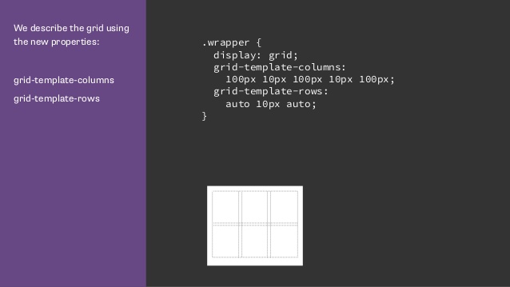

Slide 15
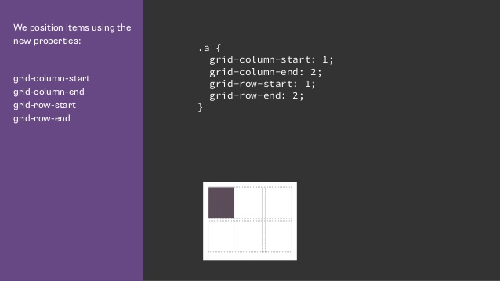

Slide 16
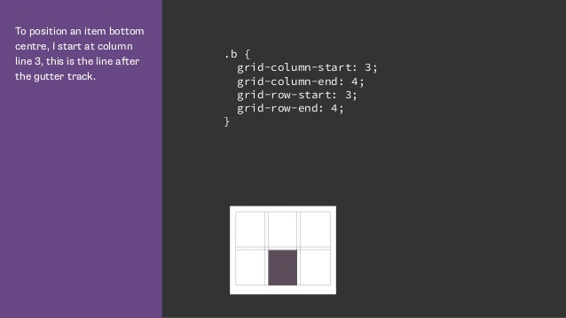

Slide 17
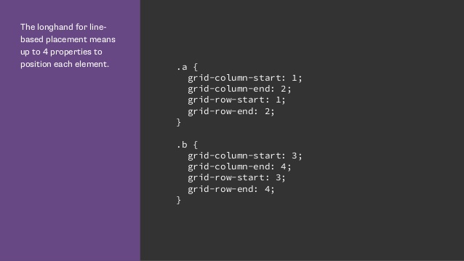

Slide 18
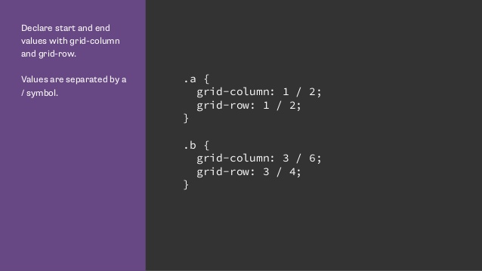

Slide 19
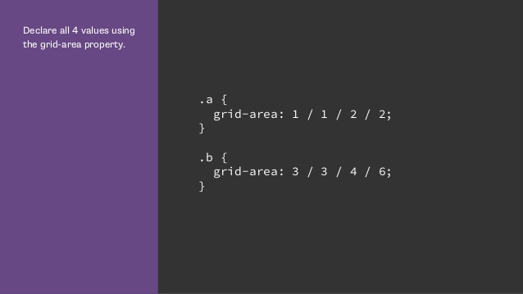

Slide 20
Grid lines can be explicit or implicit
Explicit grid lines are those specified using grid-template-rows or grid-template-columns.
Implicit lines are created when you place something into a row or column track outside of the explicit grid.
Default behavior is those tracks are auto sized. You can specify a size with the grid-auto-columns and grid-auto-rows properties.
And some more concepts like
Auto-Fill and Auto-fit
grid-auto-flow

Slide 21
Thank You ! Switch to Demos

